Slide 1
High School Drama Synthesis Prompt
Please preserve the credits in order to acknowledge those who have created this awesome assignment. Consider placing credits here OR at the end of your presentation.
Put your newly acquired synthesis skills to practice.
*Link to T. Scholtz’s Intro to Synthesis HERE
*Link to T. Freitas and K. Storms original pdf prompt HERE
Adapted by Tamara Scholtz;
original concept by Timm Freitas and Kaytie Storms

Slide 2
CONTENTS OF THIS ASSIGNMENT
A slide which will look similar to the first page of a timed synthesis prompt
A series of interactive slides wherein you will interact with the prompt itself
Each of the sources; You will annotate the sources.
A planning page for drafting your advice
A slide which will include your advice, written with your audience in mind
A reflection to review your final product
**You may work on this assignment P.I.G. style (partner, individual or group), just make sure that after you have shared, you “make a copy” of the final assignment to submit.
Refer back to the introduction assignment as necessary.

Slide 3
2020 AP ENGLISH LANGUAGE AND COMPOSITION FREE-RESPONSE QUESTIONS
ENGLISH LANGUAGE AND COMPOSITION
SECTION II
Total time - 55 minutes
Question 1
The other day, Marc Tetreault and his girlfriend of 6 months, Carly McIntosh, got in a rather large fight because he went to a bonfire at his friend Matt’s house without her (Carly and Matt don’t get along, so Marc knew she wouldn’t have had fun anyway). Now, they seemed to be getting along for the last 2 weeks—but since the fight, a lot of information has been revealed; and now Marc needs to make a decision about his relationship.
Read the following sources and accompanying contextual information carefully. Then, in a statement that synthesizes from at least three of the sources for support, develop a position about how Marc should handle his situation with Carly.

Slide 4
01
Review the PROMPT
This part should take you about 5 minutes in a timed setting

Slide 5
Turn the Prompt into a question:
Prompt in form of question here:
In a statement that synthesizes from at least three of the sources for support, develop a position about how Marc should handle his situation with Carly.

Slide 6
Who are My StakEholders?: This Will be the audience for the statement. Who would care about this and why? You May revise this after seeing what the sources have to say.
NameS/Groups
Why?
NameS/Groups
Why?
NameS/Groups
Why?
Feel free to name as many individuals or groups who might be involved and who might care about this. Keep adding text boxes...Think about who would read your statement. This will be your audience.

Slide 7
SUMMARIZE YOUR PROMPT AND DECIDE why the INFORMATION COULD BE IMPORTANT. How could it help you develop your position?
Your turn:
Summary:
So what ?:

Slide 8
At this point, what issues might I consider? What sorts of things might my stakeholders care about?
Issues and Rationale Here:
$SEEITT
$ consider economic issues such as costs, jobs, and other financial issues
S represents SAFETY (health and medical issues)
E stands for ETHICS (values, morals, beliefs)
E symbolizes the ENVIRONMENT (natural, political, or social)
I equals INTERNATIONAL IMPACT
T stands for TECHNOLOGICAL ISSUES
T represents TIME

Slide 9
IF I had to Write a Thesis right now, even though I haven’t looked at any sources, what would it be?
Enter thesis (This is your preliminary answer to the question you asked yourself on slide 5. You will revise this AFTER looking at the sources):
Enter

Slide 10
02
Review the SOURCES
This part should take you about 10 minutes in a timed setting

Slide 11
GETTING INFORMATION FROM THE SOURCES
While reading the sources, mark (+) for things that may support your argument (–) for things that you may use as a concession. Highlight any SUPER quotes or blurbs. Your quotes should never be more than about five words long, but if something is said well, USE IT.
Remember, think about your audience and what would matter to them...You only need to use 3 sources. DO NOT use any more than 4 at the most. Avoid a tour of the sources.
Insert text boxes for comments wherever needed.

Slide 12
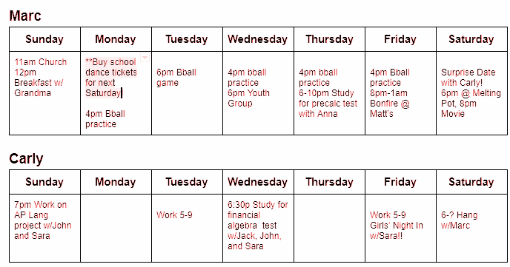
Source A: Schedules
How could it support my argument or provide a counter to my argument? (Do this box even if you won’t use it.)
Any quotables? If so, type them in the box.
Will I use this source? (Must use at least 3, try to limit to no more than 4)

Slide 13
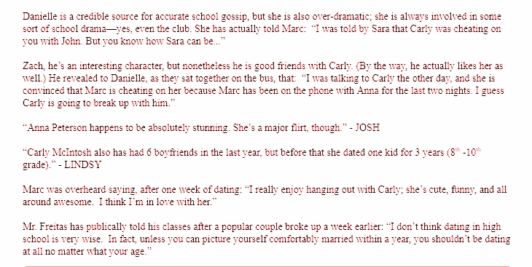
Source B: Statements
How could it support my argument or provide a counter to my argument? (Do this box even if you won’t use it.)
Any quotables? If so, type them in the box.
Will I use this source? (Must use at least 3, try to limit to no more than 4)

Slide 14
Source C: Seventeen Magazine
How could it support my argument or provide a counter to my argument? (Do this box even if you won’t use it.)
Any quotables? If so, type them in the box.
Will I use this source? (Must do at least 3, try to limit to no more than 4)
10 Reasons Being Single in Your Teens is the Best
Seventeen Magazine
1. You can crush on ~anyone~, ~any time~, ~anywhere~. This is a beautiful thing. Cutie in math class? On it. That guy sitting in your row at the movie theater? Yep. That girl you stumbled across on Tumblr who has the coolest taste in music on the planet? Uh huh.
2. You have time to do a million things. Like going to swim practice, making smoothies at Devon's house, and babysitting little Aidan next door. And that's only Monday. If you were in a relationship and spending all your free time with bae, you might not have time for all the awesomesauce that's currently in your life.
3. You're learning exactly who you are. Figuring out who you are is hard enough without the added pressure of focusing on how to be a girlfriend, too. When you're single, you don't have to worry if you're into fantasy football because Tyler's into it, or if you *actually* like it because you're good at it.
4. Your girl squad rivals Taylor Swift's. Not saying that girls in relationships can't have amazing friendships too, but when you're single, your girl squad is everything. You don't have to worry about splitting your time, or if your friends and S.O. get along, so your bond with your besties is stronger than ever.
5. It's NBD if you've never officially dated anyone. That's super common in high school and even college, so you're not alone.
6. You always get to choose what to watch on Netflix. Let's face it, compromising on a two-hour movie sucks.
7. You're saving a ton of money. When you're dating someone, you're constantly dropping $10 on pizza, or $50 on killer concert tickets for their birthday. And then there's all the money you're spending on gas to drive back and forth between your houses all the time.
8. No one gets jealous when you stare at Harry Styles' dreamy green eyes for, like, 10,000 hours. Or write fan fic about Harry sweeping you off your feet and spending his entire year off from One Direction traveling the world together. Or when you snap pics of you and Harry with hearts and "Mrs. Harry Styles" drawn all over them.
9. You can pick the best college for you without worrying about what it means for your relationship. There's no stressing over whether you're applying to the same schools, or if you want to try a long-distance relationship. The #1 priority? YOU. Where do YOU want to go to school? What do YOU want to do with your life? What makes sense for YOU?
10. You can focus 100 percent on whatever's going on with Haleb and Spoby and Ezria. Relationship drama on TV is stressful enough, k thx? No need to add IRL relationship drama. Plus when it's just you and your girls, it's an unspoken rule that Tuesday is PLL night, no questions asked. Nobody interrupts you every five seconds to ask dumb questions about who Charles is, or whines to alternate channels with the show bae wants to watch at the same time.

Slide 15
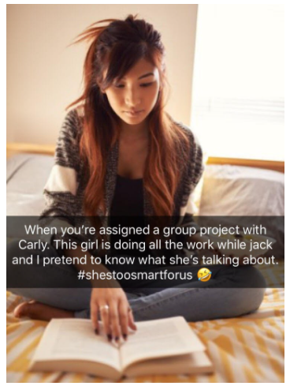
Source D: Sara’s SnapChat Story
How could it support my argument or provide a counter to my argument? (Do this box even if you won’t use it.)
Any quotables? If so, type them in the box.
Will I use this source? (Must use at least 3, try to limit to no more than 4)

Slide 16
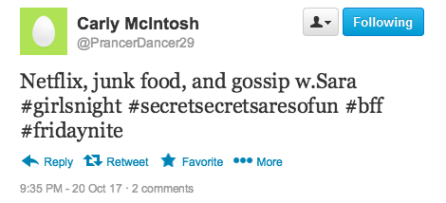
Source E: Twitter
How could it support my argument or provide a counter to my argument? (Do this box even if you won’t use it.)
Any quotables? If so, type them in the box.
Will I use this source? (Must use at least 3, try to limit to no more than 4)

Slide 17
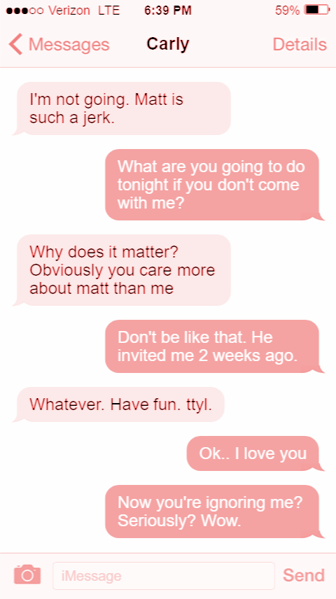
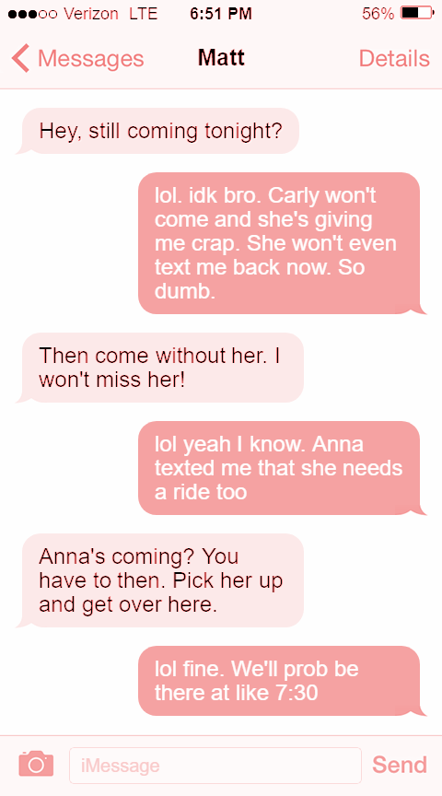
Source F: Text Messages on Marc’s Phone
How could it support my argument or provide a counter to my argument? (Do this box even if you won’t use it.)
Any quotables? If so, type them in the box.
Will I use this source? (Must use at least 3, try to limit to no more than 4)

Slide 18

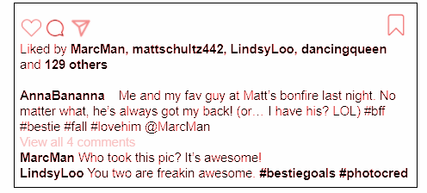
Source G: Anna’s Instagram
How could it support my argument or provide a counter to my argument? (Do this box even if you won’t use it.)
Any quotables? If so, type them in the box.
Will I use this source? (Must use at least 3, try to limit to no more than 4)

Slide 19
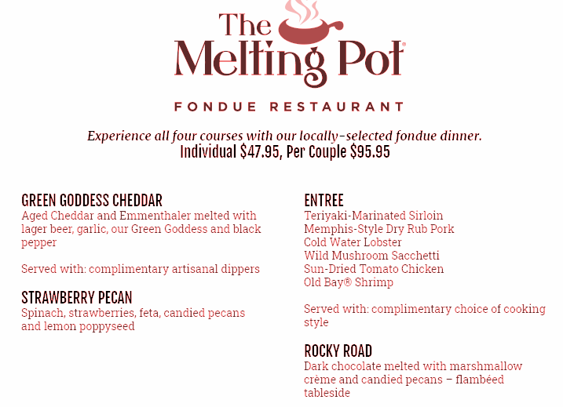
Source H: Melting Pot Menu
How could it support my argument or provide a counter to my argument? (Do this box even if you won’t use it.)
Any quotables? If so, type them in the box.
Will I use this source? (Must use at least 3, try to limit to no more than 4)

Slide 20
03
Planning your ESSAY
This part should take you about 8 minutes in a timed setting

Slide 21
1. Revise your thesis statement. Can you think of an anecdote to lead into it? Revise your stakeholders if necessary. Who will you be thinking about as your writing? Who would care? What about the $SEEITT? Any new revelations?
2. Briefly outline your support paragraphs--remember to begin each with a topic sentence that includes a claim reflecting your position.
In a synthesis essay, you should always consider opposing views
*Where will you include each source?
*What additional evidence could you include?
3. Remember that your ability to show a conversation between the sources is evidence of more complex thinking.
*Where could you include two sources that both support a particular position?
*Where could you evaluate two or more sources that address the same issue?
*How could you contrast two sources that show differing views?
Jot down some thoughts on the next slides:

Slide 22

Consider HEXAGONAL THINKING
Trying for that unicorn point? Consider how your sources might relate to one another. It’s not NECESSARY, but it can strengthen your essay. Take a look at this graphic, and try it out with your sources.

Slide 23
PREWRITING: What Are your Thoughts?

Slide 24
04
Writing your RESPONSE
This part should take you about 28 minutes in a timed setting, Leave yourself 4 minutes to reread and revise.

Slide 25
Source A (Schedules)
Source B (Statements)
Source C (Seventeen)
Source D (Snapchat)
Source E (Twitter)
Source F (Text Messages)
Source G (Instagram)
Source H (Melting Pot Menu)
In your response you should do the following:
Respond to the prompt with a thesis that presents a defensible position.
Select and use evidence from at least 3 of the provided sources to support your line of reasoning. Indicate clearly the sources used through direct quotation, paraphrase, or summary. Sources may be cited as Source A, Source B, etc., or by using the description in parentheses.
Explain how the evidence supports your line of reasoning.
Use appropriate grammar and punctuation in communicating your argument.

Slide 26
Quick hints and reminders:
Lead into your thesis. It needs to be clear and state your position. NO SOURCES IN YOUR INTRODUCTION.
All body paragraphs should include YOUR claims. Your topic sentences should be your claims and should NOT include sources. The sources come later in the paragraph as evidence to support your claim.
Think of building your paragraphs with assertion, evidence, commentary.
Be cognizant that the situation is nuanced. Realize that others will see the situation differently. Meet their objections, but refute.
End with a conclusion.
Hmmm...

Slide 27
Your FINAL advice goes here:

Slide 28
REVIEW!
Did you have an introduction which led into a clear thesis that states your position?
Did you use and cite a minimum of 3 sources?
Did you make sure YOUR argument was central and you used the sources to support YOUR argument? (NO TOUR OF THE SOURCES!)
Did you keep in mind your intended audience and use support and counter arguments which would appeal to them?

Slide 29
Student produced answer:
It is very common for high school relationships to get messy and complicated. These couples start out in a honeymoon bliss, but struggle when disagreements arise; and the situation is not made any better by the extreme gossip that is surely to follow. While it may take a little bit of time to see, sometimes it is necessary to give up on a relationship that is a lost cause. Since Carly does not return the affection that Mark gives her and lacks a serious attitude about their relationship, it is time for Marc to let Carly go and move on with his life.
Marc has given Carly so much affection, attention, and time that Carly has not returned, that there is no reason for him to continue to put forth the effort of maintaining the relationship. When comparing Marc’s and Carly’s schedules from source A, it is clear that Marc is extremely busy and still makes time for Carly, while Carly has much more freetime, but barely mentions Marc. Marc’s schedule is completely filled and includes buying dance tickets and taking Carly on a surprise date, which according to source H, is a really nice and expensive dinner at The Melting Pot. Meanwhile, Carley’s schedule has plenty of free time, yet only includes one “hang with Marc.” This clearly shows that Marc is the one putting in all the effort for Carly while Carly barely notices everything that Marc does for her. There is no reason for Marc to continue to put himself through the pain and mental torment of a one sided relationship.
Additionally, Carly has not taken their relationship seriously, leaving only one good option: Marc needs to leave Carly. As seen in source F, the text messages on Marc’s phone, Marc made an effort to foster an open and honest relationship when asking Carly “What are you going to be doing tonight…?” In the most immature fashion, Carly vaguely responded and went on to ignore him. This kind of behavior is that of someone who is not ready for the kind of serious relationship that Marc is looking for. Some gossipers might say that the texts on Marc’s phone showing he gave Anna a ride to the bonfire prove that Marc is just as guilty as Carly. This is not true. It is clear that Anna was the one that asked for the ride, not the other way around. Marc was still fully committed to Carly, displaying the maturity and seriousness that Carly cannot provide.
The good news is that dating in high school is risk free. You are still young and figuring out what you are looking for, so it is ok to choose someone to date then decide that they are not for you. Marc and Carly’s relationship is an example of this because while Carly is just looking to have fun, Marc wants something more. By leaving Carly, Marc will be one step closer to finding the right person for him and that is what matters most.

